Slide 1
Weekly Poor PDP Case Review
Aug 3 - Aug 16, 2026

Slide 2
Weekly Poor PDP Case Review
Overview | Aug 3 - Aug 16, 2026
Metric | Value
Total Poor Case in last 2 weeks | 70
Total Types of Product | 20
Total Case related to Log Team (%) | 51 (72.9%)
Total Case not related to Log Team (%) | 19 (27.1%)

Slide 3
Weekly Poor PDP Case Review
Problems Pattern | Aug 3 - Aug 16, 2026
Problem | Cases | Products | %
包裝問題 | 23 | 13 | 45.1%
其他 | 20 | 10 | 39.2%
溫度問題 | 4 | 3 | 7.8%
儲存問題 | 2 | 1 | 3.9%
原箱問題 | 1 | 1 | 2.0%
罐裝問題 | 1 | 1 | 2.0%

Slide 4
Weekly Poor PDP Case Review
Comparison of Performance by Districts | Aug 3 - Aug 16, 2026
Rank | District | Cases | Rep. Product (ID + Name) | % of Log Team
1 | NT-TM | 12 | H0888001_S_P10003353 | [原箱] 純蒸餾水 700ml x 24支 | 23.5%
2 | ETX | 8 | H0888001_S_10137015 | 鈣思寶高鈣植物固醇豆奶 250毫升9包裝 (新舊包裝隨機發送)... | 15.7%
3 | WTK | 7 | H0888001_S_P10003353 | [原箱] 純蒸餾水 700ml x 24支 | 13.7%
4 | ETK | 5 | H9558001_S_B371 | SC037星益生趣 凍乾生肉貓糧 鴨朋鵝友(鴨肉及鵝肉配方) 18oz... | 9.8%
5 | WTX | 5 | H1115001_S_10091021 | 硬豆腐 (冷凍)【最佳食用期限不少於3天】 | 9.8%
6 | NT-ST | 4 | H9431001_S_WHC01012 | 補腦潤眼 迷你易吞 ｜小金蛋95％高純度魚油＋維他命D3 60... | 7.8%
7 | NT-TW | 4 | H0888001_S_10021200A | 罐裝可口可樂汽水 x 2 (新舊包裝隨機發送) | 7.8%
8 | ETH | 3 | H0888001_S_10010657G | 北海道特選3.6牛乳 200毫升 x 8 | 5.9%
9 | NT-TSM | 2 | H0888001_S_10021200A | 罐裝可口可樂汽水 x 2 (新舊包裝隨機發送) | 3.9%
10 | WTH | 1 | H8260001_S_50000001 | 玉泉 梳打水 - 原箱 320毫升 (新舊包裝隨機發送) | 2.0%
Total Log Team Cases: 51 | Sum%: 99.9%

Slide 5
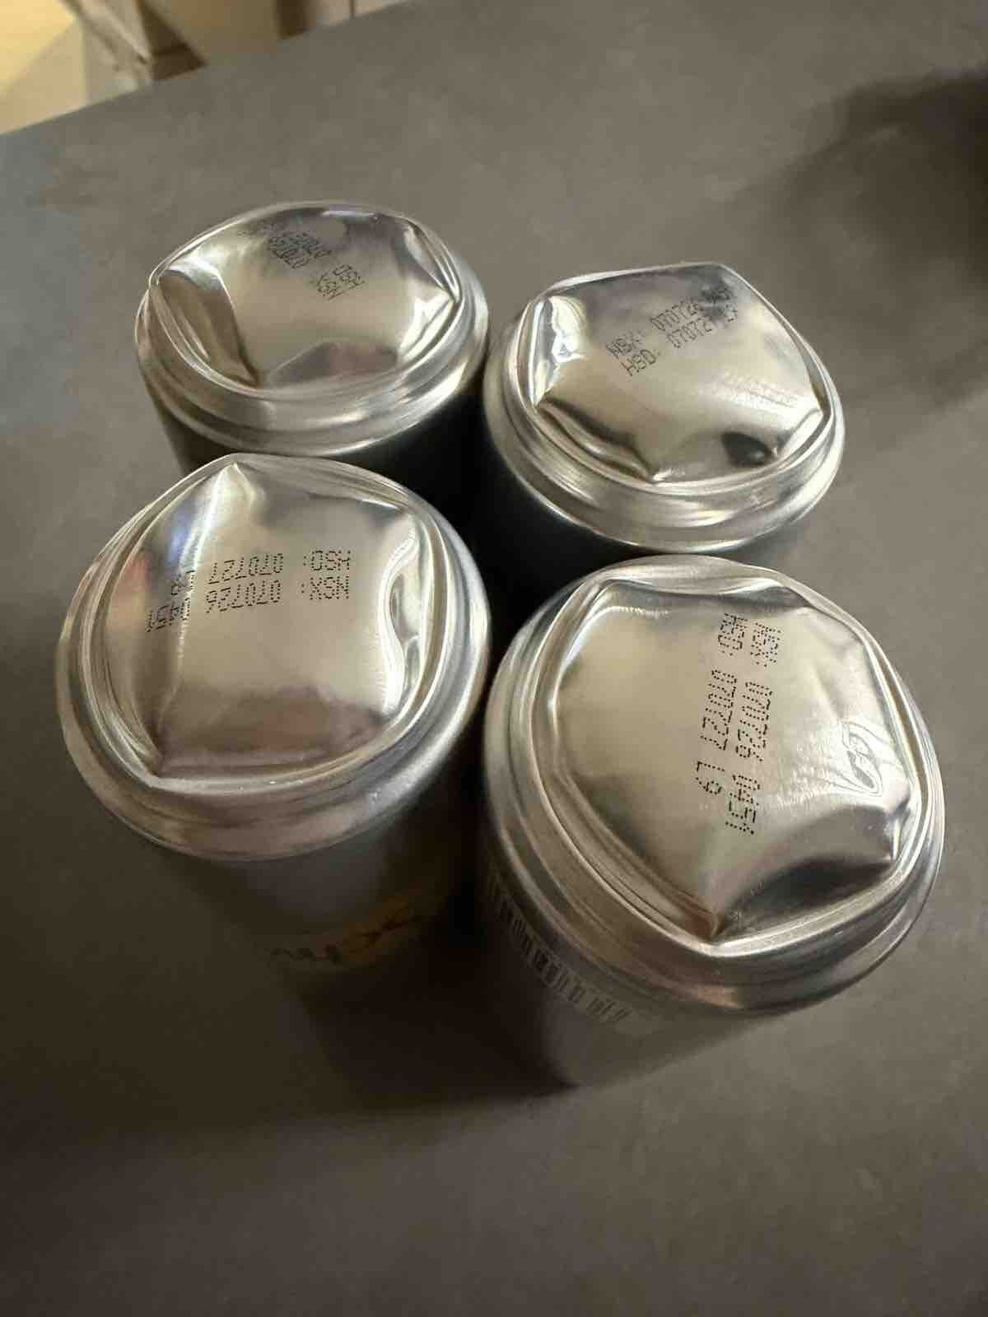
Weekly Poor PDP Case Review
Case Review - 包裝問題 (23 cases in window)
Product ID: H8260001_S_50000001 | 玉泉 梳打水 - 原箱 320毫升 (新舊包裝隨機發送)
District: ETK
Shipping Warehouse: 將軍澳倉
Pickpack Warehouse: Merchant貨
Order: H260809552800 | Waybill: 8117346039
Checking Result: 因天氣炎熱 溫差所導致問題
底部凸起晒 好差 慎買
1/2

Slide 6
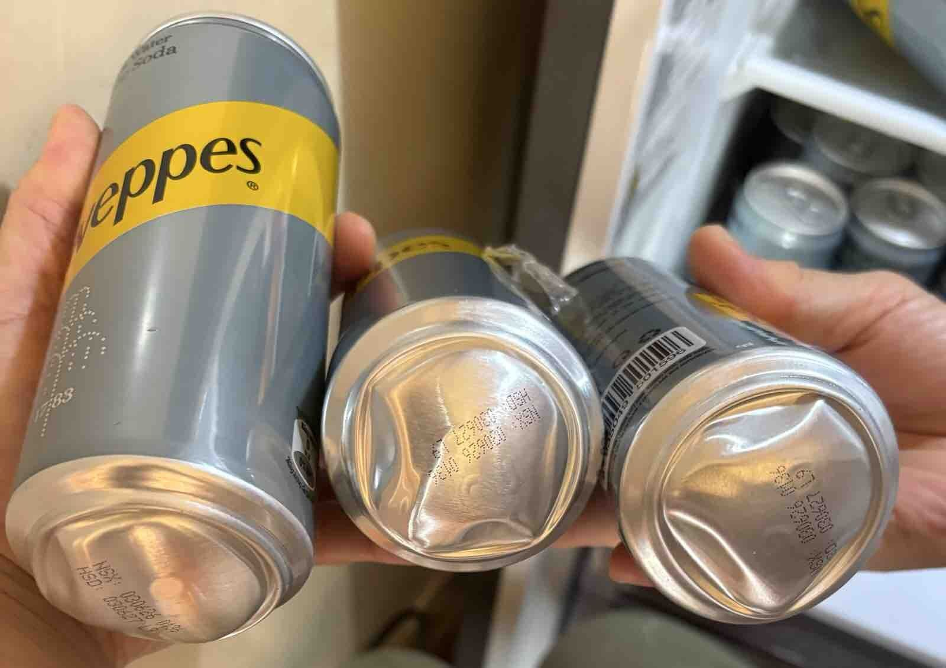
Weekly Poor PDP Case Review
Case Review - 包裝問題 (23 cases in window)
Product ID: H8260001_S_50000001 | 玉泉 梳打水 - 原箱 320毫升 (新舊包裝隨機發送)
District: NT-TM
Shipping Warehouse: 屯門倉
Pickpack Warehouse: Merchant貨
Order: H260803508338 | Waybill: 8104972936
Checking Result: 凸罐未非物流問題 倉庫保存問題
1 pack 有3罐，和1 pack 有l罐，罐底有凸起，請問咩原因？
2/2

Slide 7
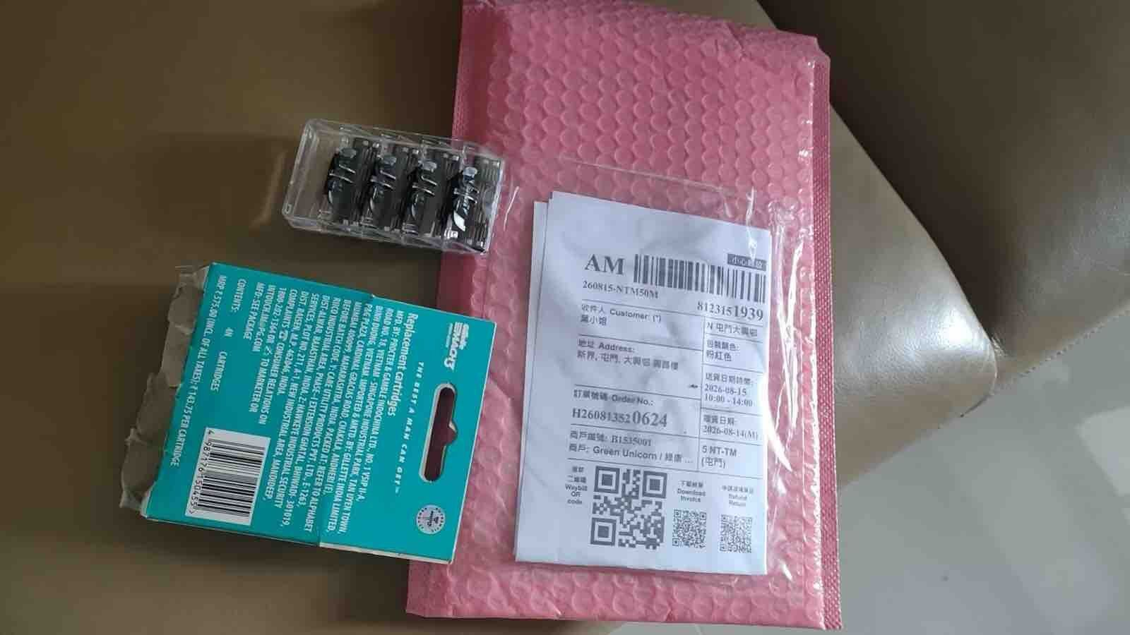
Weekly Poor PDP Case Review
Case Review - 其他 (20 cases in window)
Product ID: H0888001_S_P10003353 | [原箱] 純蒸餾水 700ml x 24支
District: NT-TM
Shipping Warehouse: 屯門倉
Pickpack Warehouse: Warehouse貨
Order: H260813520624 | Waybill: 8123151920-2
Checking Result: 供應商漏貨
買8片刀頭，只收到4片

Slide 8
Weekly Poor PDP Case Review
Case Review - 溫度問題 (4 cases in window)
No case with valid unique photo available for this category.

Slide 9
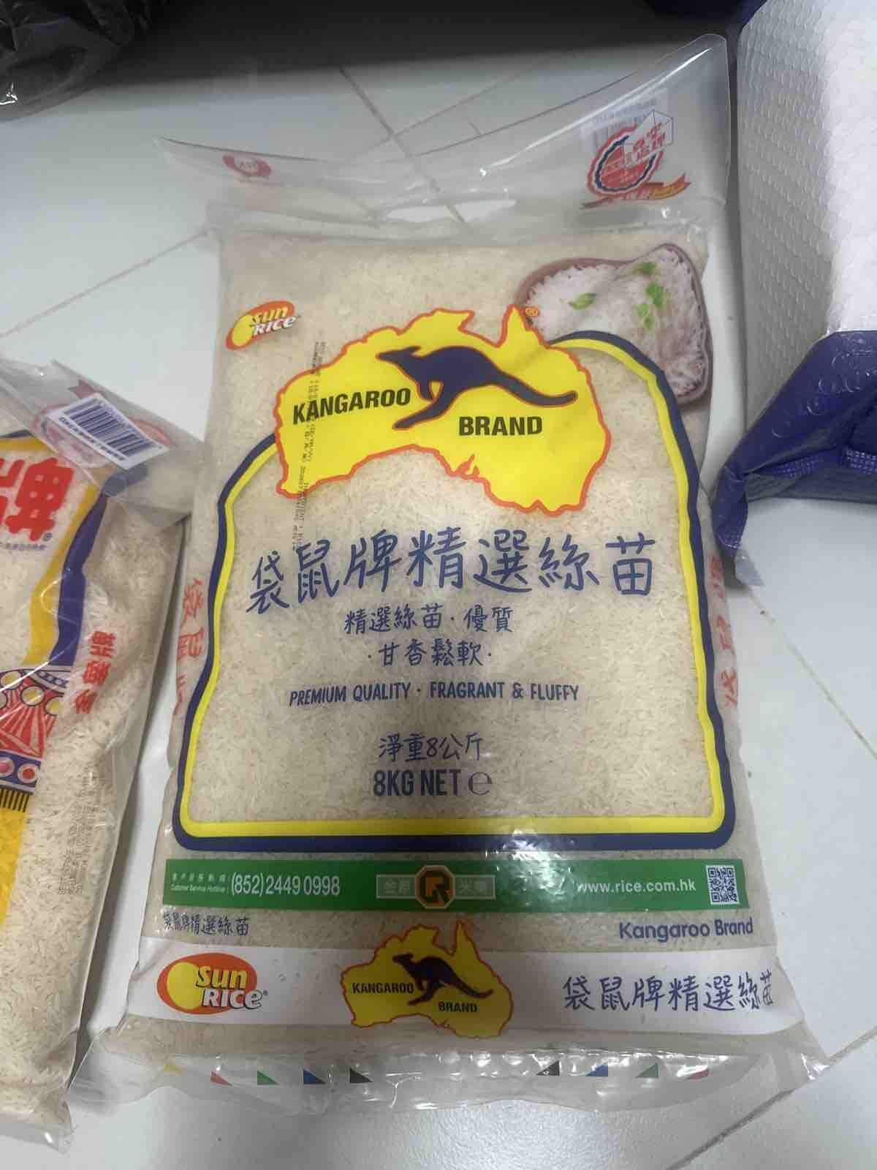
Weekly Poor PDP Case Review
Case Review - 儲存問題 (2 cases in window)
Product ID: H0888001_S_10018178 | 精選絲苗米 #袋鼠#袋鼠牌#絲苗米#米#煮食#煮飯#煲仔飯 [新舊包裝隨機發貨]
District: ETK
Shipping Warehouse: 將軍澳倉
Pickpack Warehouse: Warehouse貨
Order: H260809553183 | Waybill: 8117363512-2
Checking Result: 出貨時已非真空
每次喺HKTVmall買米都沒有真空
1/2

Slide 10
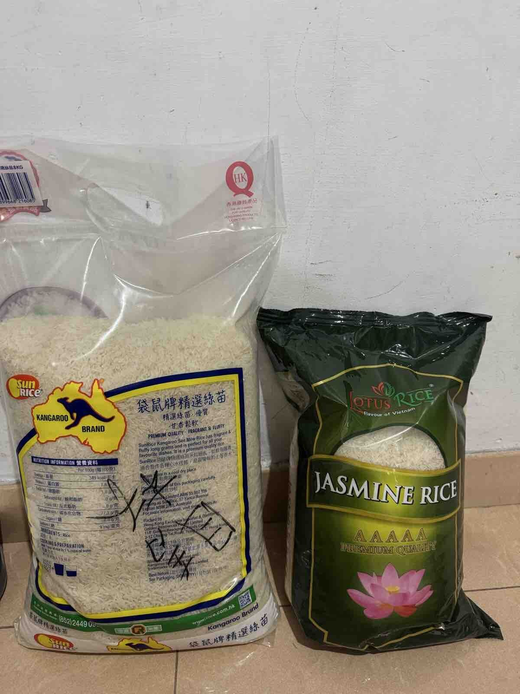
Weekly Poor PDP Case Review
Case Review - 儲存問題 (2 cases in window)
Product ID: H0888001_S_10018178 | 精選絲苗米 #袋鼠#袋鼠牌#絲苗米#米#煮食#煮飯#煲仔飯 [新舊包裝隨機發貨]
District: WTX
Shipping Warehouse: 青衣倉
Pickpack Warehouse: Warehouse貨
Order: H260801527978 | Waybill: 8100759660-1
Checking Result: 貨品品質問題
不是真空包裝
2/2

Slide 11
Weekly Poor PDP Case Review
Case Review - 原箱問題 (1 cases in window)
No case with valid unique photo available for this category.

Slide 12
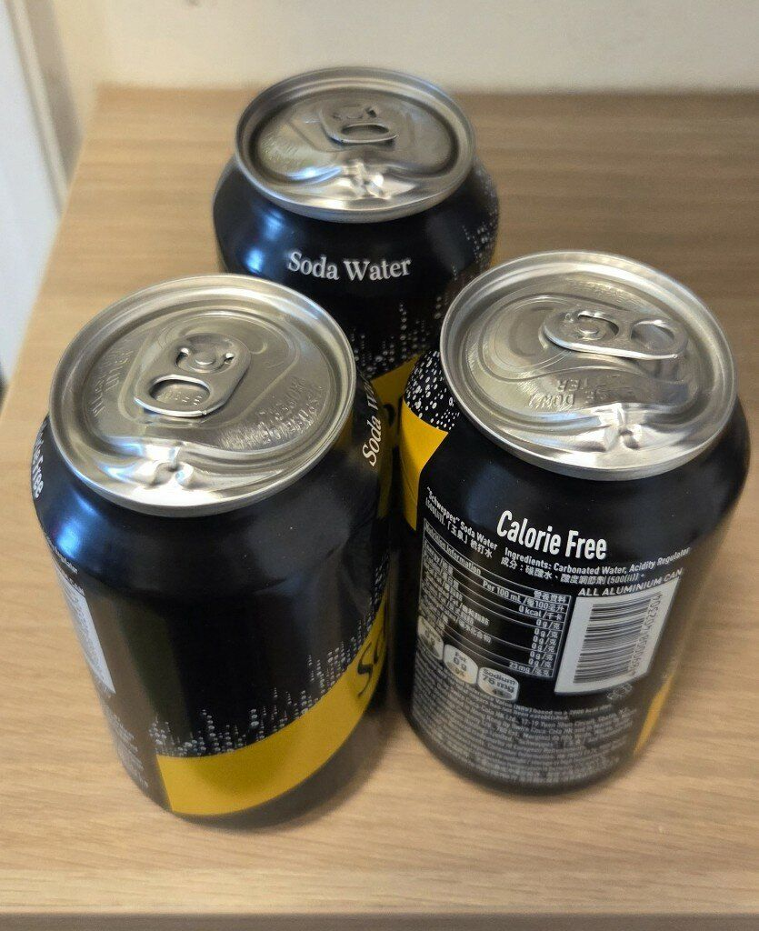
Weekly Poor PDP Case Review
Case Review - 罐裝問題 (1 cases in window)
Product ID: H0888001_S_10136268A | 玉泉梳打水330ml x 8罐裝 x 2 (新舊包裝隨機發送)
District: NT-TW
Shipping Warehouse: 青衣倉
Pickpack Warehouse: Warehouse貨
Order: H260807533485 | Waybill: 8112107934-1
Checking Result: 凸罐未非物流問題 倉庫保存問題
今天收貨打開有3罐有問題，罐面凸起，要求更換，謝謝！

